Slide 1
Epistemology of thermodynamics
True because we say so (i.e., by definition, or by choice of experimental condition)
True because math works
True because of how nature works (we think)

Slide 2

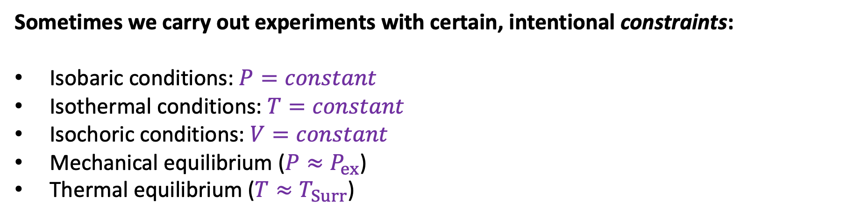
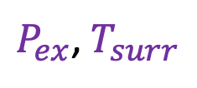
I. True because we say so (i.e., by definition, or by choice of experimental conditions)
Sometimes we carry out experiments with certain, intentional constraints:
Isobaric conditions: $P=constant$
Isothermal conditions: $T=constant$
Isochoric conditions: $V=constant$
Mechanical equilibrium ($P≈P_{ex}$)
Thermal equilibrium ($T{≈T}_{Surr}$)
$P$, $T$
$P_{ex}$, $T_{surr}$

Slide 3

I. True because we say so (i.e., by definition, or by choice of experimental conditions)
Question: How do we know that $H=U+PV$?
Answer: …
Question: How do we know that $G=H−TS$?
Answer: …

Slide 4

I. True because we say so (i.e., by definition, or by choice of experimental conditions)
Question: How do we know that $H=U+PV$?
Answer: Because $H≡U+PV$
Question: How do we know that $G=H−TS$?
Answer: …

Slide 5
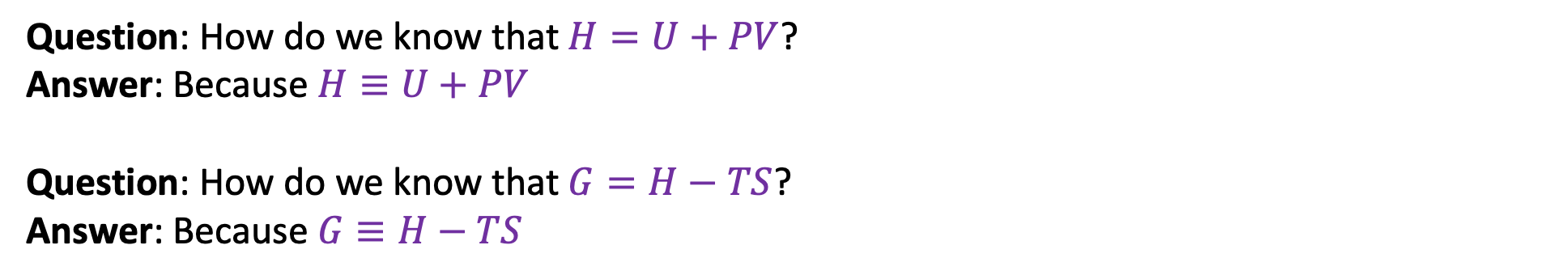
I. True because we say so (i.e., by definition, or by choice of experimental conditions)
Question: How do we know that $H=U+PV$?
Answer: Because $H≡U+PV$
Question: How do we know that $G=H−TS$?
Answer: Because $G≡H−TS$

Slide 6
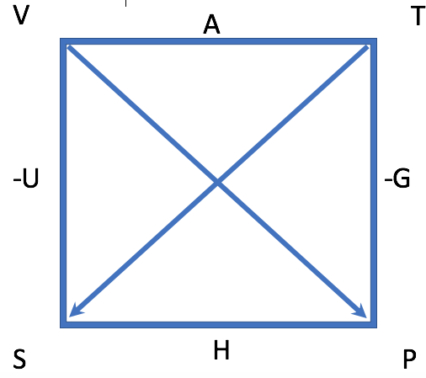
I. True because we say so (i.e., by definition, or by choice of experimental conditions)
Follow-up insight: The energies in The Box (A, G, H, and U) were all invented because they are useful in some way.

Slide 7
II. True because math works
Question: How do we know that the Gibbs energy is a state function?
Answer: …

Slide 8
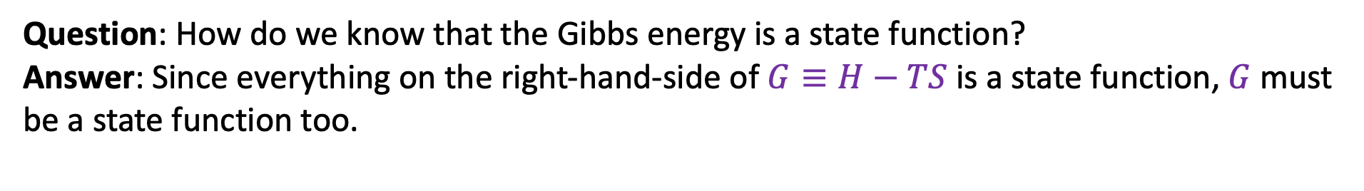
II. True because math works
Question: How do we know that the Gibbs energy is a state function?
Answer: Since everything on the right-hand-side of $G≡H−TS$ is a state function, $G$ must be a state function too.

Slide 9
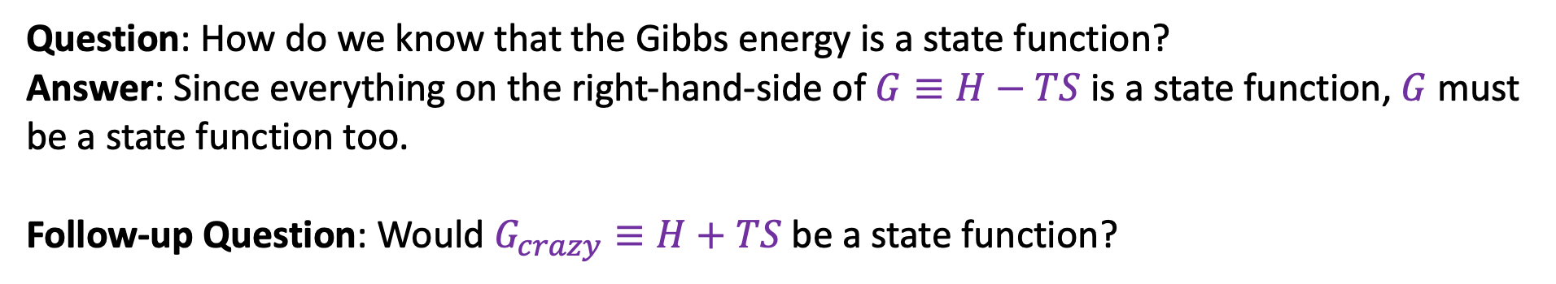
II. True because math works
Question: How do we know that the Gibbs energy is a state function?
Answer: Since everything on the right-hand-side of $G≡H−TS$ is a state function, $G$ must be a state function too.
Follow-up Question: Would $G_{crazy}≡H+TS$ be a state function?

Slide 10
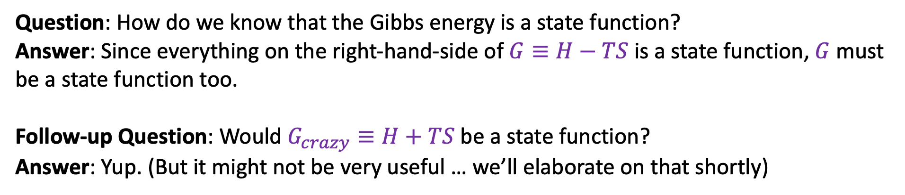
II. True because math works
Question: How do we know that the Gibbs energy is a state function?
Answer: Since everything on the right-hand-side of $G≡H−TS$ is a state function, $G$ must be a state function too.
Follow-up Question: Would $G_{crazy}≡H+TS$ be a state function?
Answer: Yup. (But it might not be very useful … we’ll elaborate on that shortly)

Slide 11
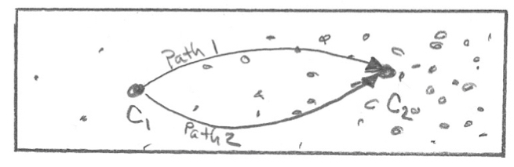
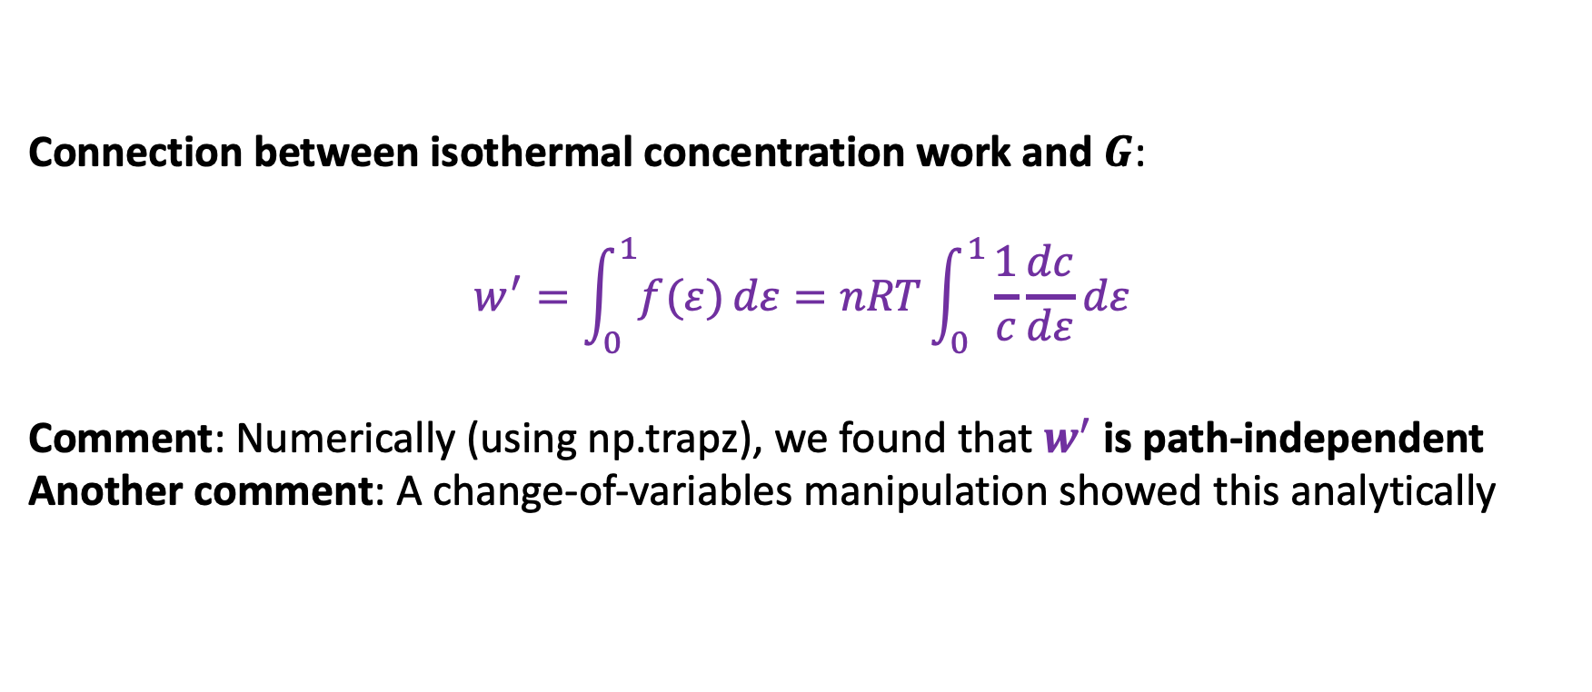


II. True because math works
Connection between isothermal concentration work and $G$:
$$w^{′}=\int_{0}^{1}{f(ε)}dε=nRT\int_{0}^{1}{\frac{1}{c}\frac{dc}{dε}}dε$$
Comment: Numerically (using np.trapz), we found that $w^{′}$ is path-independent
Another comment: A change-of-variables manipulation showed this analytically
$$ε=0$$
$$ε=1$$

Slide 12
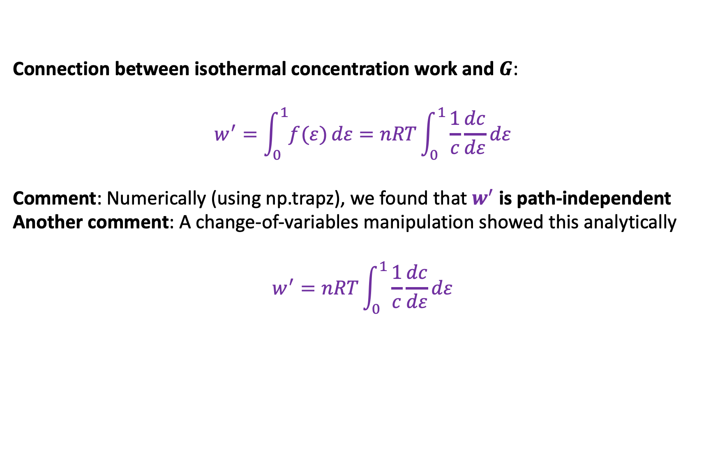
II. True because math works
Connection between isothermal concentration work and $G$:
$$w^{′}=\int_{0}^{1}{f(ε)}dε=nRT\int_{0}^{1}{\frac{1}{c}\frac{dc}{dε}}dε$$
Comment: Numerically (using np.trapz), we found that $w^{′}$ is path-independent
Another comment: A change-of-variables manipulation showed this analytically
$$w^{′}=nRT\int_{0}^{1}{\frac{1}{c}\frac{dc}{dε}}dε$$
$$ε=0$$
$$ε=1$$

Slide 13
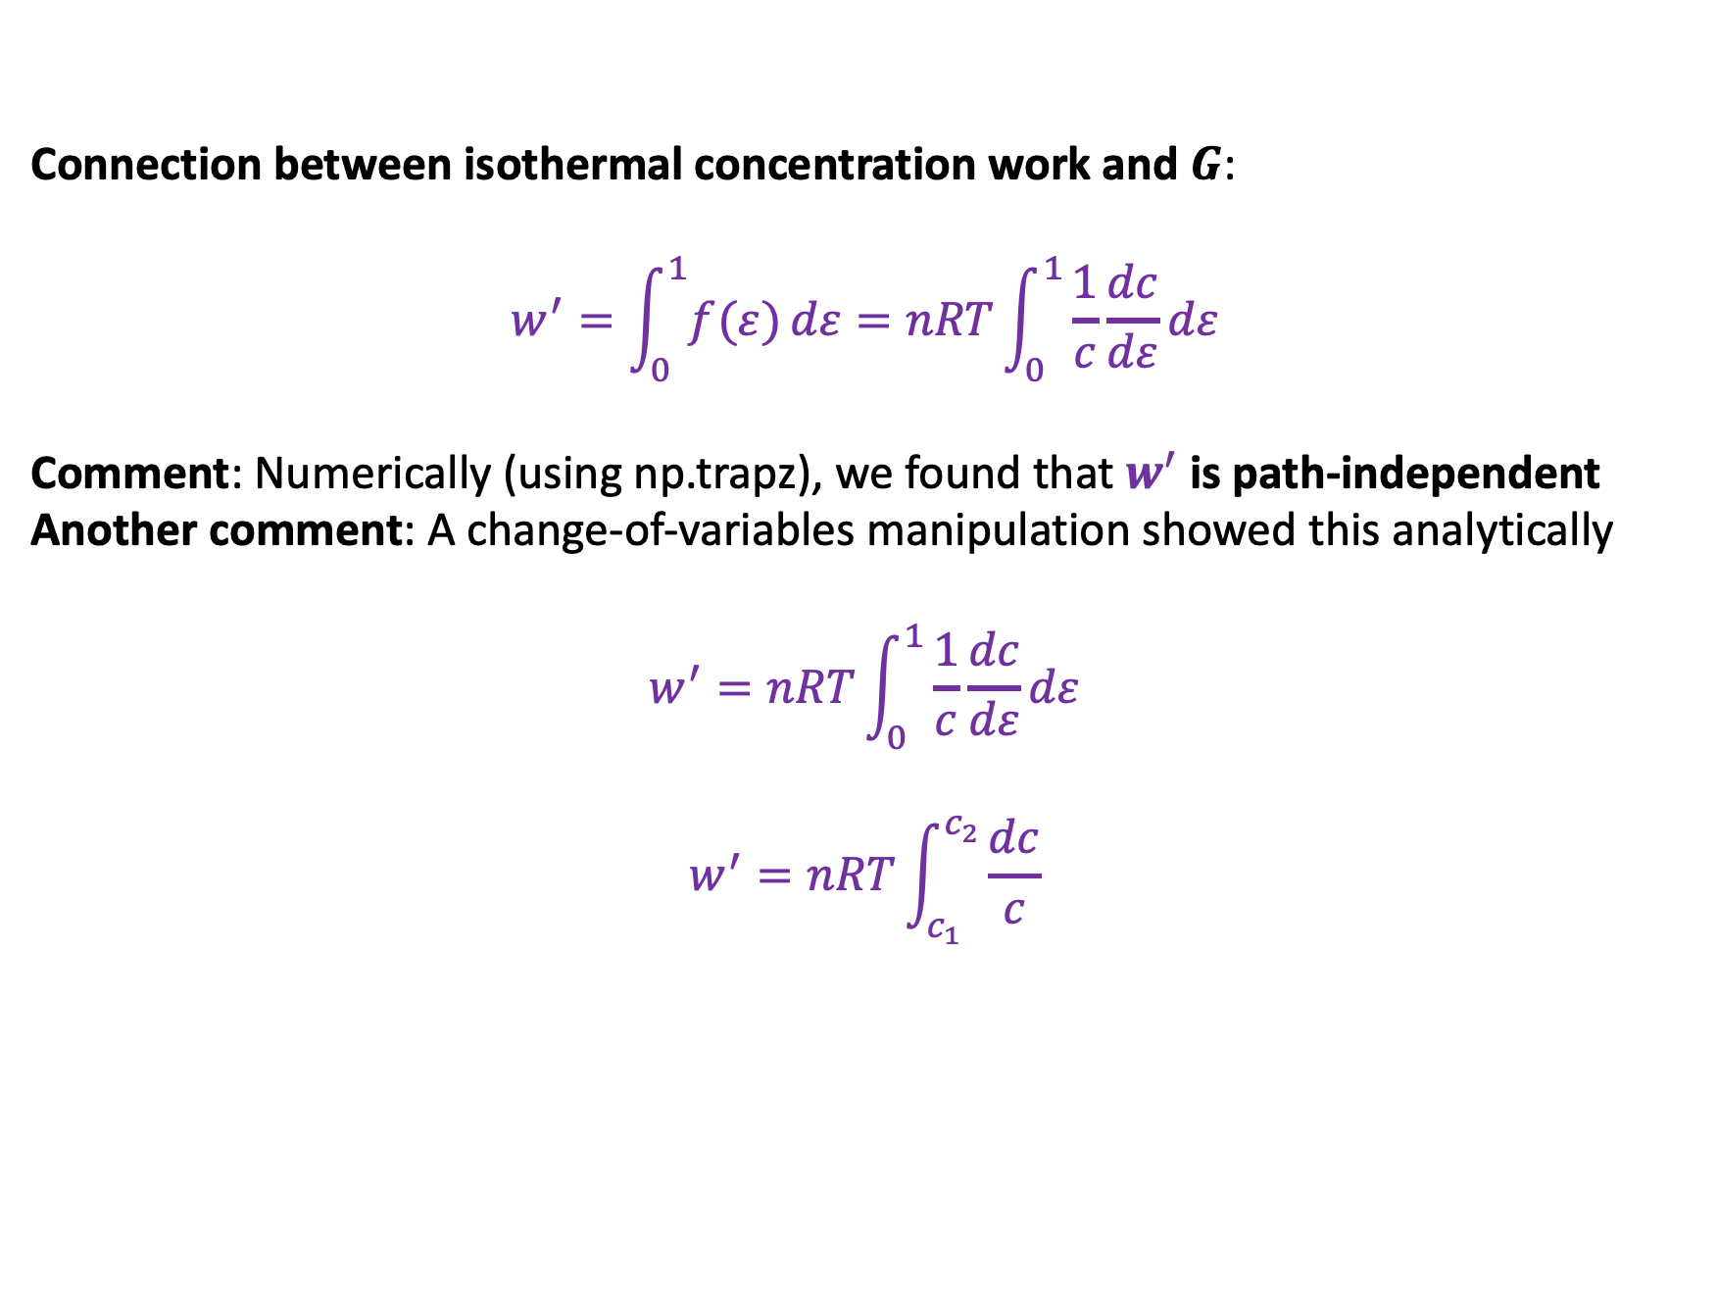
II. True because math works
Connection between isothermal concentration work and $G$:
$$w^{′}=\int_{0}^{1}{f(ε)}dε=nRT\int_{0}^{1}{\frac{1}{c}\frac{dc}{dε}}dε$$
Comment: Numerically (using np.trapz), we found that $w^{′}$ is path-independent
Another comment: A change-of-variables manipulation showed this analytically
$$w^{′}=nRT\int_{0}^{1}{\frac{1}{c}\frac{dc}{dε}}dε$$
$$w^{′}=nRT\int_{c_{1}}^{c_{2}}{\frac{dc}{c}}$$
$$ε=0$$
$$ε=1$$

Slide 14
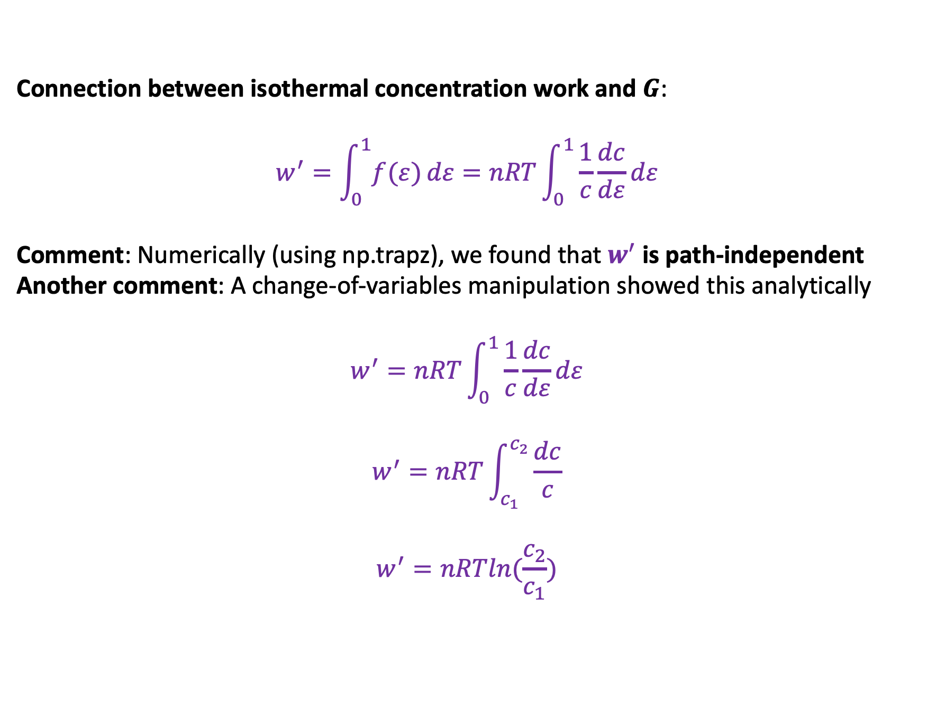
II. True because math works
Connection between isothermal concentration work and $G$:
$$w^{′}=\int_{0}^{1}{f(ε)}dε=nRT\int_{0}^{1}{\frac{1}{c}\frac{dc}{dε}}dε$$
Comment: Numerically (using np.trapz), we found that $w^{′}$ is path-independent
Another comment: A change-of-variables manipulation showed this analytically
$$w^{′}=nRT\int_{0}^{1}{\frac{1}{c}\frac{dc}{dε}}dε$$
$$w^{′}=nRT\int_{c_{1}}^{c_{2}}{\frac{dc}{c}}$$
$$w^{′}=nRTln(\frac{c_{2}}{c_{1}})$$
$$ε=0$$
$$ε=1$$

Slide 15
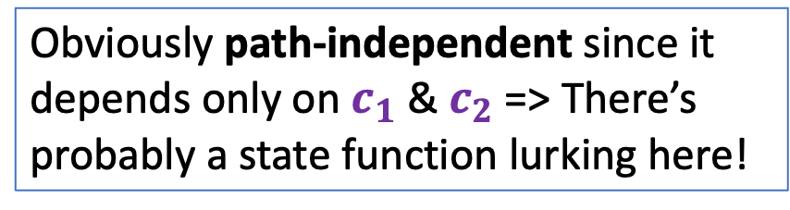
II. True because math works
Connection between isothermal concentration work and $G$:
$$w^{′}=\int_{0}^{1}{f(ε)}dε=nRT\int_{0}^{1}{\frac{1}{c}\frac{dc}{dε}}dε$$
Comment: Numerically (using np.trapz), we found that $w^{′}$ is path-independent
Another comment: A change-of-variables manipulation showed this analytically
$$w^{′}=nRT\int_{0}^{1}{\frac{1}{c}\frac{dc}{dε}}dε$$
$$w^{′}=nRT\int_{c_{1}}^{c_{2}}{\frac{dc}{c}}$$
$$w^{′}=nRTln(\frac{c_{2}}{c_{1}})$$
$$ε=0$$
$$ε=1$$
Obviously path-independent since it depends only on $c_{1}$ & $c_{2}$ => There’s probably a state function lurking here!

Slide 16
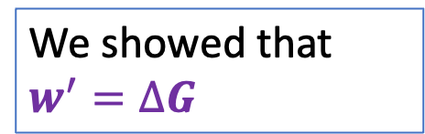
II. True because math works
Connection between isothermal concentration work and $G$:
$$w^{′}=\int_{0}^{1}{f(ε)}dε=nRT\int_{0}^{1}{\frac{1}{c}\frac{dc}{dε}}dε$$
Comment: Numerically (using np.trapz), we found that $w^{′}$ is path-independent
Another comment: A change-of-variables manipulation showed this analytically
$$w^{′}=nRT\int_{0}^{1}{\frac{1}{c}\frac{dc}{dε}}dε$$
$$w^{′}=nRT\int_{c_{1}}^{c_{2}}{\frac{dc}{c}}$$
$$w^{′}=nRTln(\frac{c_{2}}{c_{1}})$$
$$ε=0$$
$$ε=1$$
Obviously path-independent since it depends only on $c_{1}$ & $c_{2}$ => There’s probably a state function lurking here!
We showed that $w^{′}=∆G$

Slide 17
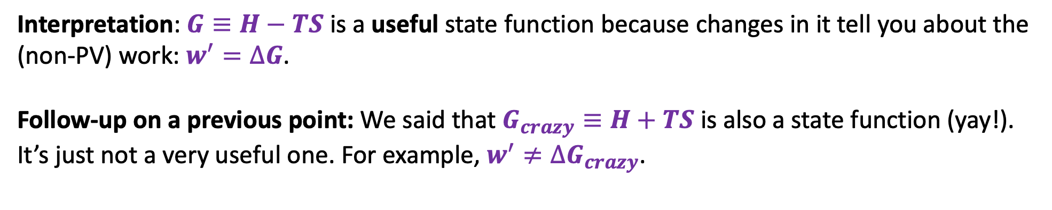
II. True because math works
Interpretation: $G≡H−TS$ is a useful state function because changes in it tell you about the (non-PV) work: $w^{′}=∆G$.
Follow-up on a previous point: We said that $G_{crazy}≡H+TS$ is also a state function (yay!). It’s just not a very useful one. For example, $w^{′}≠∆G_{crazy}$.

Slide 18
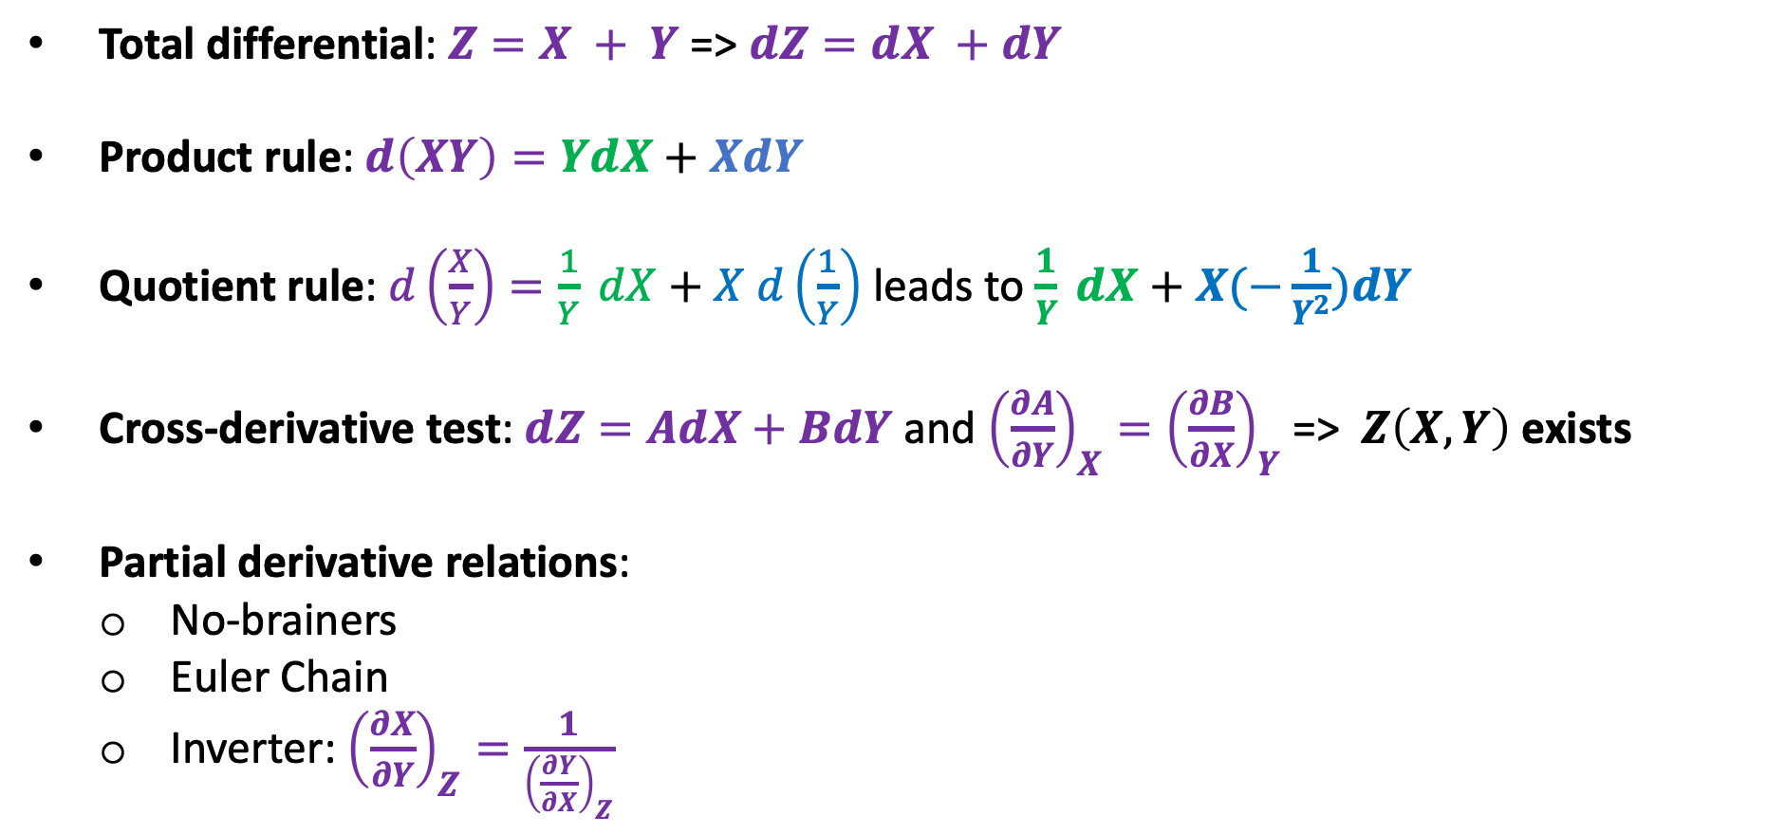
II. True because math works
Total differential: $Z=X + Y$ => $dZ=dX +dY$
Product rule: $d\left(XY\right)=YdX+XdY$
Quotient rule: $d\left(\frac{X}{Y}\right)=\frac{1}{Y} dX+X d\left(\frac{1}{Y}\right)$ leads to $\frac{1}{Y} dX+$ $X(−\frac{1}{Y^{2}})dY$
Cross-derivative test: $dZ=AdX+BdY$ and ${\left(\frac{∂A}{∂Y}\right)}_{X}={\left(\frac{∂B}{∂X}\right)}_{Y}$ => $Z\left(X,Y\right)$ exists
Partial derivative relations:
No-brainers
Euler Chain
Inverter: ${\left(\frac{∂X}{∂Y}\right)}_{Z}=\frac{1}{{\left(\frac{∂Y}{∂X}\right)}_{Z}}$

Slide 19
II. True because math works
Example: What’s the total differential of the quantity $\frac{G}{T}$?

Slide 20

II. True because math works
Example: What’s the total differential of the quantity $\frac{G}{T}$?
$$d\left(\frac{G}{T}\right)=\frac{1}{T} dG+G d\left(\frac{1}{T}\right)$$

Slide 21
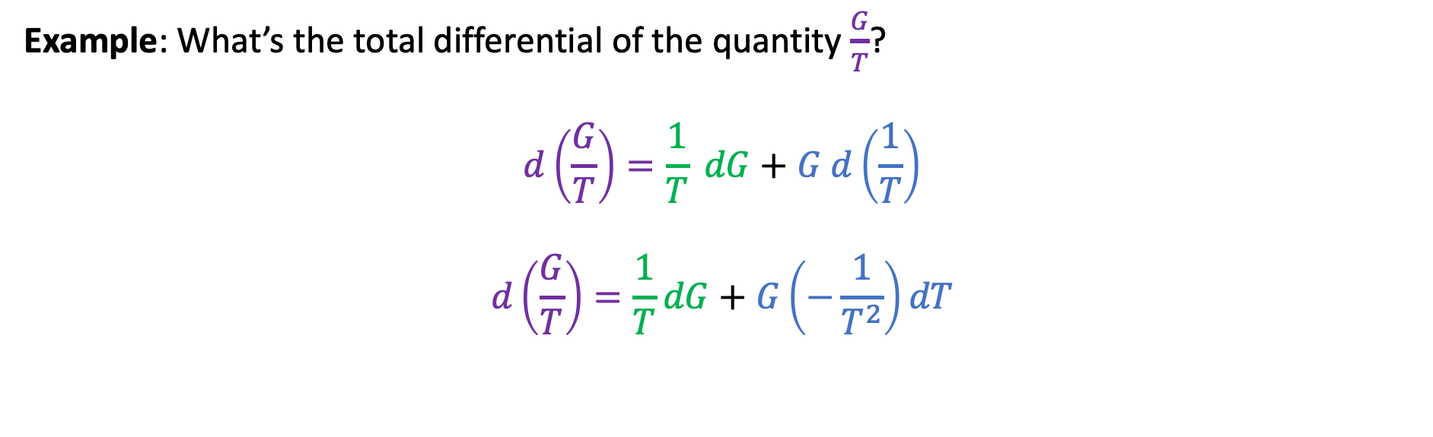
II. True because math works
Example: What’s the total differential of the quantity $\frac{G}{T}$?
$$d\left(\frac{G}{T}\right)=\frac{1}{T} dG+G d\left(\frac{1}{T}\right)$$
$$d\left(\frac{G}{T}\right)=\frac{1}{T}dG+G\left(−\frac{1}{T^{2}}\right)dT$$

Slide 22
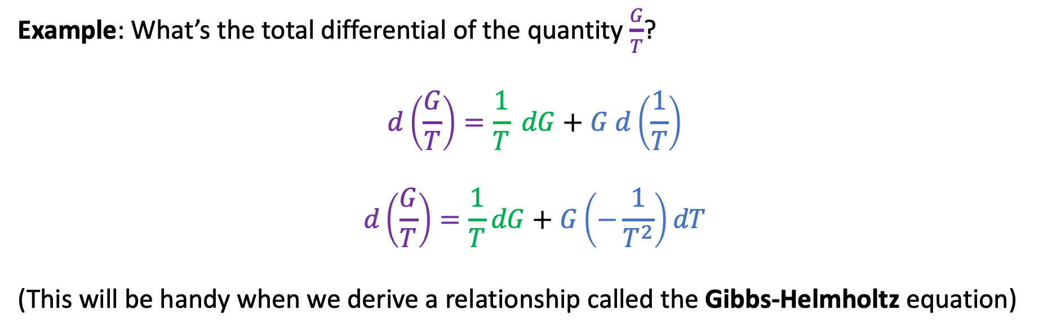
II. True because math works
Example: What’s the total differential of the quantity $\frac{G}{T}$?
$$d\left(\frac{G}{T}\right)=\frac{1}{T} dG+G d\left(\frac{1}{T}\right)$$
$$d\left(\frac{G}{T}\right)=\frac{1}{T}dG+G\left(−\frac{1}{T^{2}}\right)dT$$
(This will be handy when we derive a relationship called the Gibbs-Helmholtz equation)

Slide 23
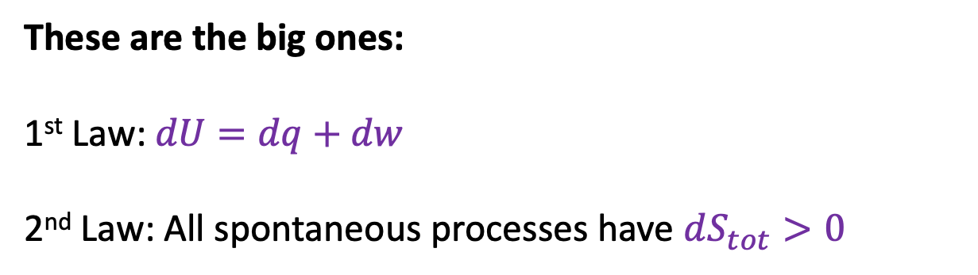
III. True because of how nature works (we think)
These are the big ones:
1st Law: $dU=dq+dw$
2nd Law: All spontaneous processes have $dS_{tot}>0$

Slide 24

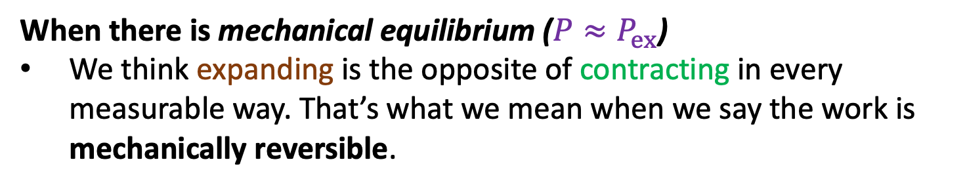
III. True because of how nature works (we think)
But there’s also the matter of reversibility
When there is mechanical equilibrium ($P≈P_{ex}$)
We think expanding is the opposite of contracting in every measurable way. That’s what we mean when we say the work is mechanically reversible.
$$dw=−P_{ex}dV$$

Slide 25
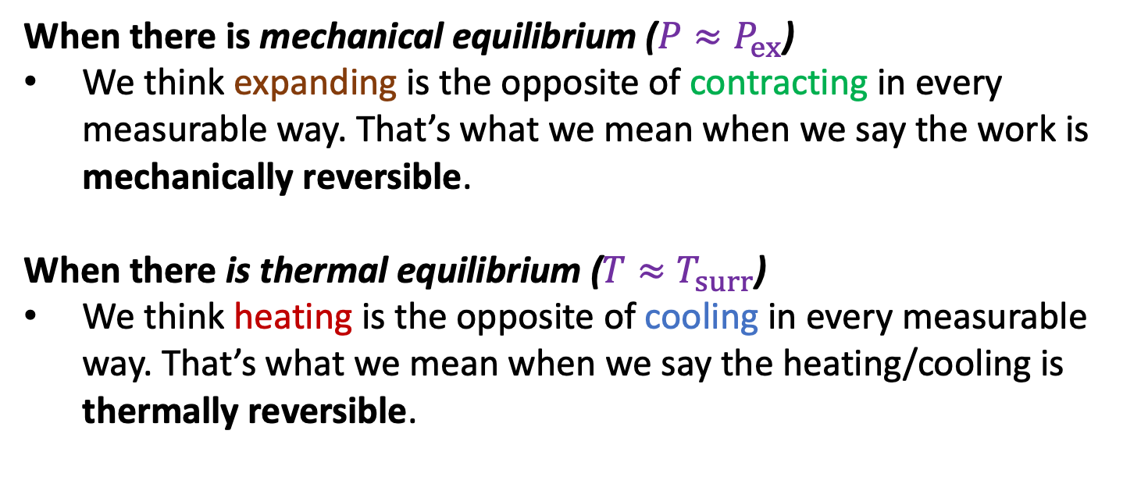

III. True because of how nature works (we think)
But there’s also the matter of reversibility
When there is mechanical equilibrium ($P≈P_{ex}$)
We think expanding is the opposite of contracting in every measurable way. That’s what we mean when we say the work is mechanically reversible.
When there is thermal equilibrium ($T≈T_{surr}$)
We think heating is the opposite of cooling in every measurable way. That’s what we mean when we say the heating/cooling is thermally reversible.
$$dw=−P_{ex}dV$$
$$dq=C×dT$$

Slide 26
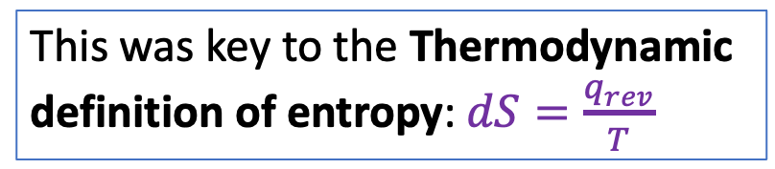
III. True because of how nature works (we think)
But there’s also the matter of reversibility
When there is mechanical equilibrium ($P≈P_{ex}$)
We think expanding is the opposite of contracting in every measurable way. That’s what we mean when we say the work is mechanically reversible.
When there is thermal equilibrium ($T≈T_{surr}$)
We think heating is the opposite of cooling in every measurable way. That’s what we mean when we say the heating/cooling is thermally reversible.
$$dw=−P_{ex}dV$$
This was key to the Thermodynamic definition of entropy: $dS=\frac{q_{rev}}{T}$
$$dq=C×dT$$

Slide 27
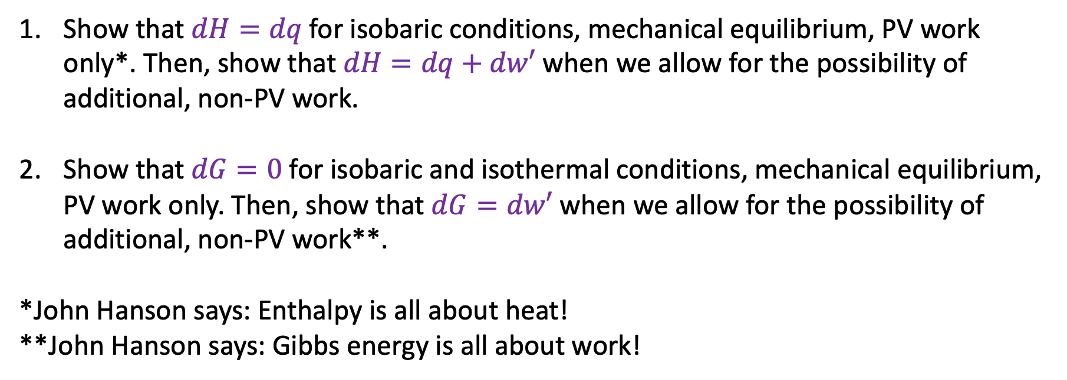
Blackboard work
Now we’re going to prove some things that we didn’t get to before
Show that $dH=dq$ for isobaric conditions, mechanical equilibrium, PV work only*. Then, show that $dH=dq+dw′$ when we allow for the possibility of additional, non-PV work.
Show that $dG=0$ for isobaric and isothermal conditions, mechanical equilibrium, PV work only. Then, show that $dG=dw′$ when we allow for the possibility of additional, non-PV work**.
*John Hanson says: Enthalpy is all about heat!
**John Hanson says: Gibbs energy is all about work!

Slide 28
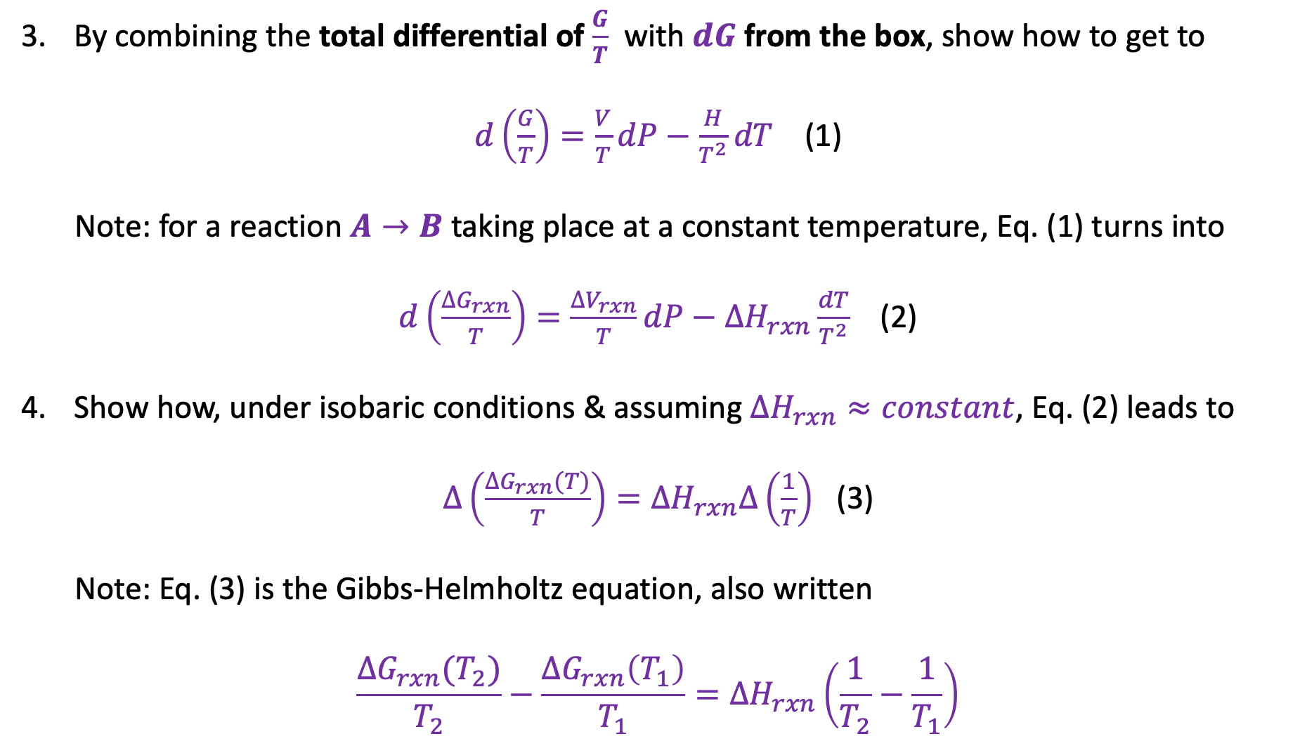
Blackboard work
Now we’re going to prove some things that we didn’t get to before
By combining the total differential of $\frac{G}{T}$ with $dG$ from the box, show how to get to
$d\left(\frac{G}{T}\right)=\frac{V}{T}dP−\frac{H}{T^{2}}dT$ (1)
Note: for a reaction $A→B$ taking place at a constant temperature, Eq. (1) turns into
$d\left(\frac{∆G_{rxn}}{T}\right)=\frac{∆V_{rxn}}{T}dP−∆H_{rxn}\frac{dT}{T^{2}}$ (2)
Show how, under isobaric conditions & assuming $∆H_{rxn}≈constant$, Eq. (2) leads to
$∆\left(\frac{∆G_{rxn}(T)}{T}\right)=∆H_{rxn}∆\left(\frac{1}{T}\right)$ (3)
Note: Eq. (3) is the Gibbs-Helmholtz equation, also written
$$\frac{∆G_{rxn}(T_{2})}{T_{2}}−\frac{∆G_{rxn}\left(T_{1}\right)}{T_{1}}=∆H_{rxn}\left(\frac{1}{T_{2}}−\frac{1}{T_{1}}\right)$$

Slide 29
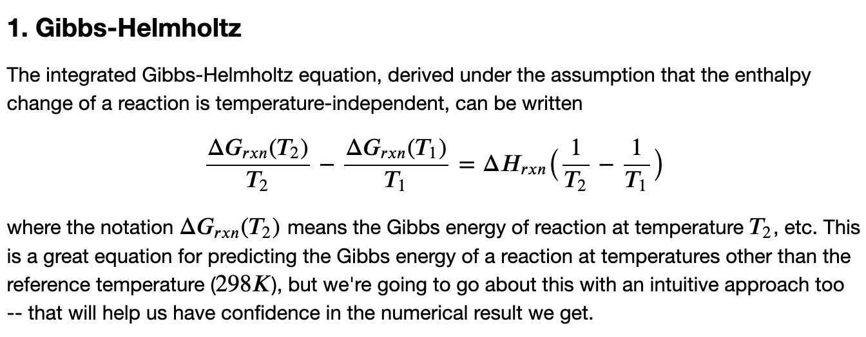
CGI work this week

